Slide 1

Transportation Sustainability and
Vehicle Emissions Prediction
A Predictive Analytics Study Using Canadian Fuel Consumption Data
Name: Indrajeet Singh
Student Number: 501409581
Supervisor’s name: Tamer Abdou
Date of Submission: 26th July 2026
Name: Indrajeet Singh
Student Number: 501409581
Supervisor’s name: Tamer Abdou
Date of Submission: 25th July 2026
GitHub Repository: https://github.com/IndrajeetSingh121/CIND820-CO2-Emission-Prediction

Slide 2

Why This Research Matters
Project Overview
Transportation is a major contributor to CO₂ emissions.
Vehicle characteristics influence vehicle emissions.
Accurate emission prediction supports sustainable transportation decisions.
This research helps compare vehicles based on their environmental impact.
Project Beneficiaries
Transportation Analysts
Policy Makers
Researchers
Consumers
Project Goal
To predict vehicle CO₂ emissions using Canadian vehicle data and identify the vehicle characteristics that contribute most to emissions.

Slide 3
Research Questions
RQ1 | RQ2 | RQ3
Vehicle Categories | Vehicle Characteristics | Fuel Consumption & CO₂ Emissions
Which vehicle categories sold in Canada between 2015 and 2024 are associated with higher CO₂ emissions, and how can this information support sustainable transportation planning? | What vehicle characteristics contribute the most to higher CO₂ emissions in Canadian light-duty vehicles, and how can these insights encourage lower-emission vehicle choices? | How can vehicle specifications such as engine size, cylinders, and fuel type help consumers compare more environmentally responsible vehicle options?

Slide 4
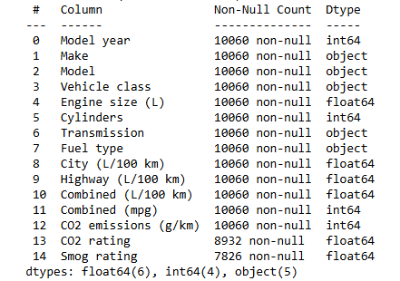
Dataset Overview
Attribute | Value
Time Period | 2015–2024
Observations | 10,060 Vehicles
Features | 15 Variables
Target Variable | CO₂ Emissions (g/km)
The dataset contains vehicle specifications, fuel consumption measures, and environmental ratings used to predict vehicle CO₂ emissions

Slide 5
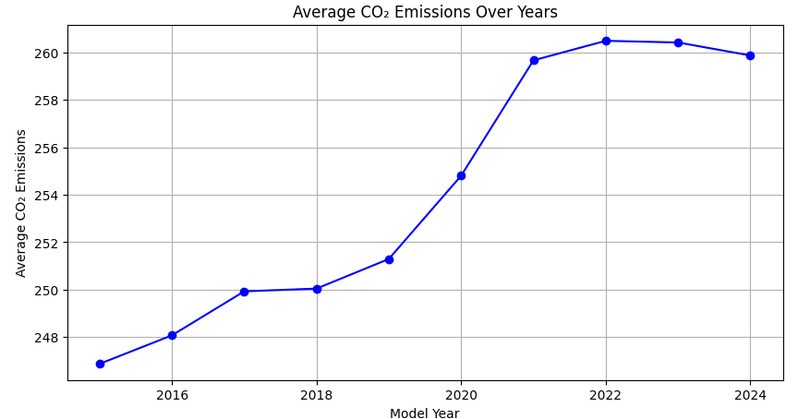
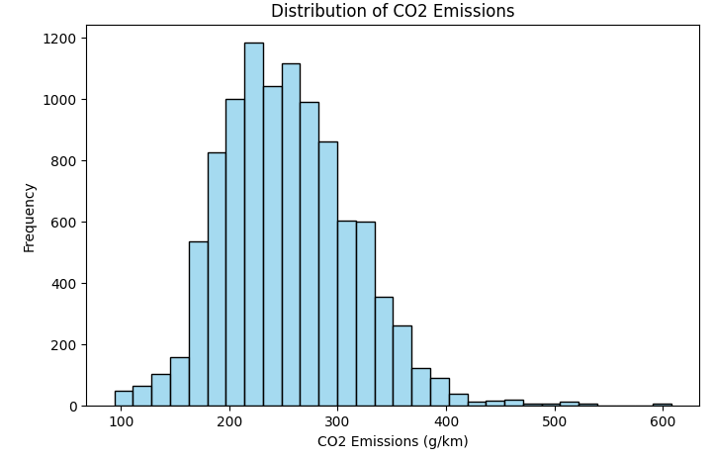
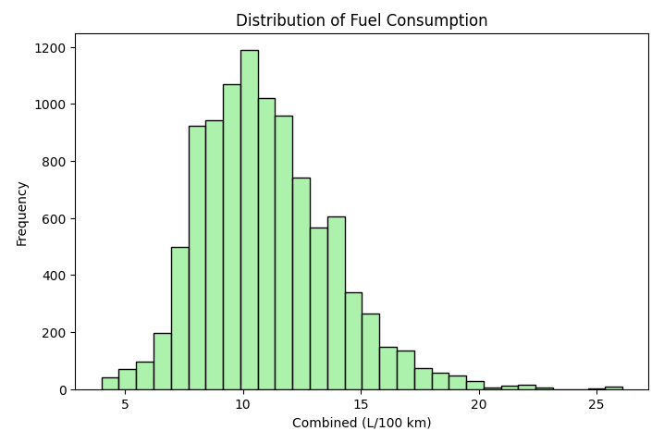
Exploratory Data Analysis (EDA)
Key Observations
Most vehicles emit 200–300 g/km of CO₂.
Fuel consumption is concentrated around 8–14 L/100 km.
Average CO₂ emissions generally increased between 2015 and 2023, with a slight decrease in 2024.
A small number of vehicles exhibit substantially higher CO₂ emissions than the majority of the dataset.

Slide 6
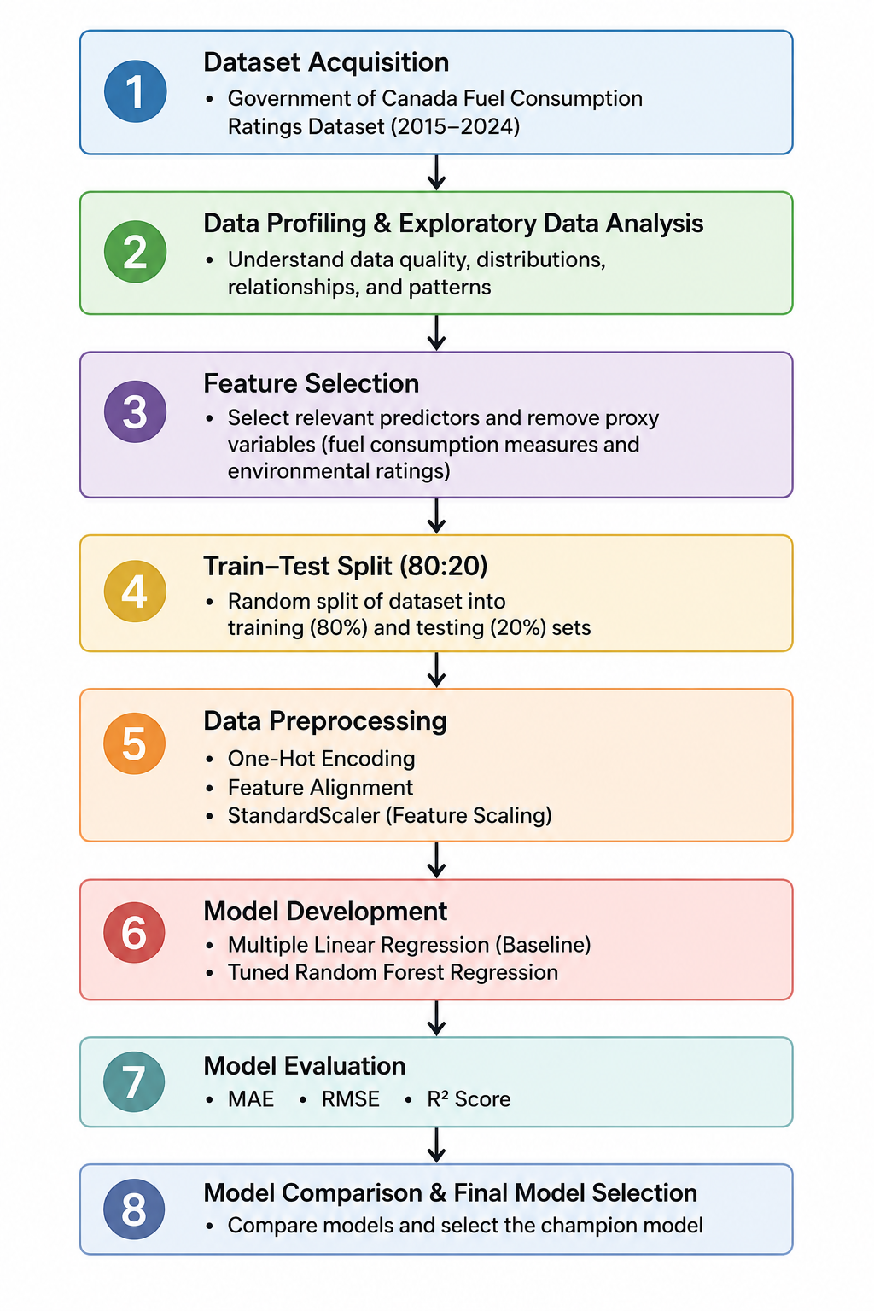
Project Methodology
Methodology Overview
Data Collection – NRCan Fuel Consumption Dataset
Data Preparation – Data cleaning, train-test split, encoding, scaling
Model Development – Multiple Linear Regression and Random Forest Regression
Model Evaluation – MAE, RMSE, and R²

Slide 7
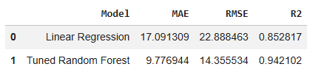
Model Development & Performance
Why These Models?
Multiple Linear Regression | Random Forest Regression
• Baseline regression model | • Comparison regression model
• Provides a benchmark for evaluating performance | • Handles non-linear
• Easy to interpret | • Improves prediction accuracy
Model Performance
Champion Model: Tuned Random Forest
Lower MAE & RMSE
Higher R²
Validated using five-fold cross-validation
Best balance of accuracy, stability & efficiency

Slide 8
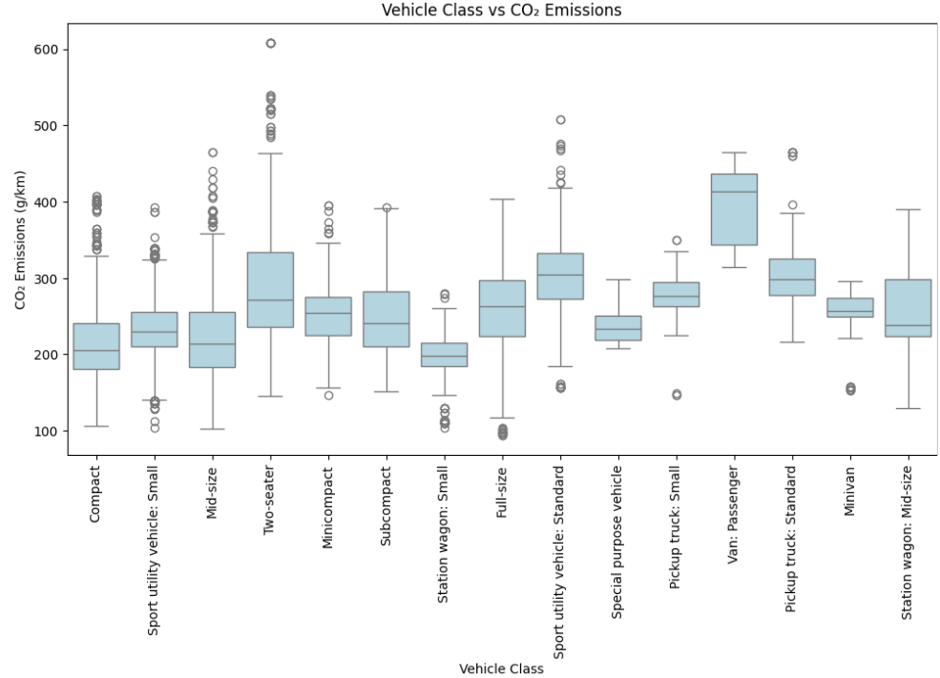
Research Question 1
Which categories of vehicles sold in Canada between 2015 and 2024 are associated with higher fuel consumption and CO₂ emissions, and how can this information support sustainable transportation planning?
Answer
Passenger vans had the highest median CO₂ emissions.
Standard SUVs and pickup trucks also showed higher emissions.
Compact vehicles generally produced lower emissions.

Slide 9
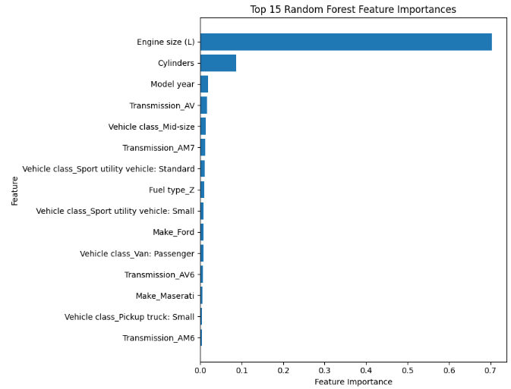
Research Question 2
What vehicle characteristics contribute the most to higher CO₂ emissions in Canadian light-duty vehicles, and how can these insights encourage lower-emission vehicle choices?
Answer
Engine size was the most influential predictor of CO₂ emissions.
Cylinder count was the second most important contributor.
Vehicle class, transmission, fuel type, and model year also influenced predictions.
These characteristics can help identify lower-emission vehicles.

Slide 10
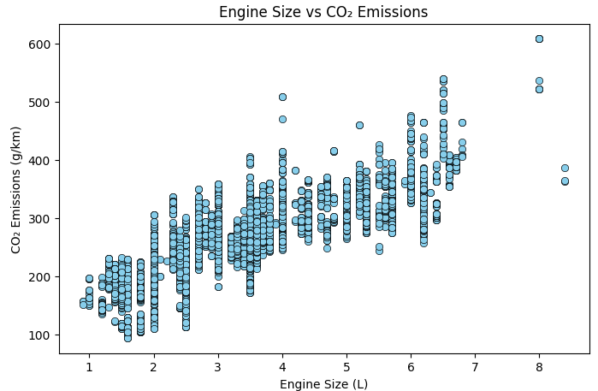
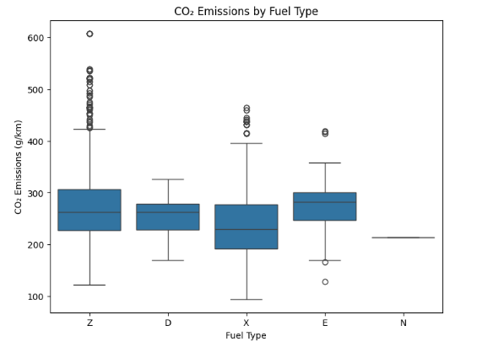
Research Question 3
How can vehicle specifications such as engine size, cylinders, and fuel type help consumers compare more environmentally responsible vehicle options?
Key Findings
Larger engines emit more CO₂.
Fuel type affects emissions.
Lower-emission options identified.
Supports informed vehicle choices.

Slide 11
Limitations & Future Work
Limitations
The dataset includes Canadian light-duty vehicles only (2015–2024).
Real-world factors such as driving behaviour, road conditions, traffic, and weather were not available.
The model predicts emissions based on vehicle specifications and may not fully represent real driving conditions.
Ethics
Uses a publicly available Government of Canada dataset with no personal or sensitive information.
The model should be used as a decision-support tool rather than an exact measure of real-world vehicle emissions.
Results should be interpreted responsibly, considering the dataset limitations and assumptions.

Slide 12
Future Work
Future Work
Incorporate real-world driving conditions, such as traffic, weather, and road gradient.
Validate the model using independent or future vehicle datasets.
Extend the study to include electric and hybrid vehicles.
Develop an interactive decision-support tool for consumers and policymakers.

Slide 13
Conclusion
Random Forest outperformed Multiple Linear Regression, achieving an R² of 0.9421.
Vehicle class, engine size, cylinders, transmission, and fuel type significantly influenced CO₂ emissions.
Larger engine vehicles generally produced higher CO₂ emissions, while smaller-engine vehicles tended to be more environmentally friendly.
The developed model can support sustainable transportation planning and help consumers compare lower-emission vehicles.

Slide 14
Thank You! Questions?

